Slide 1
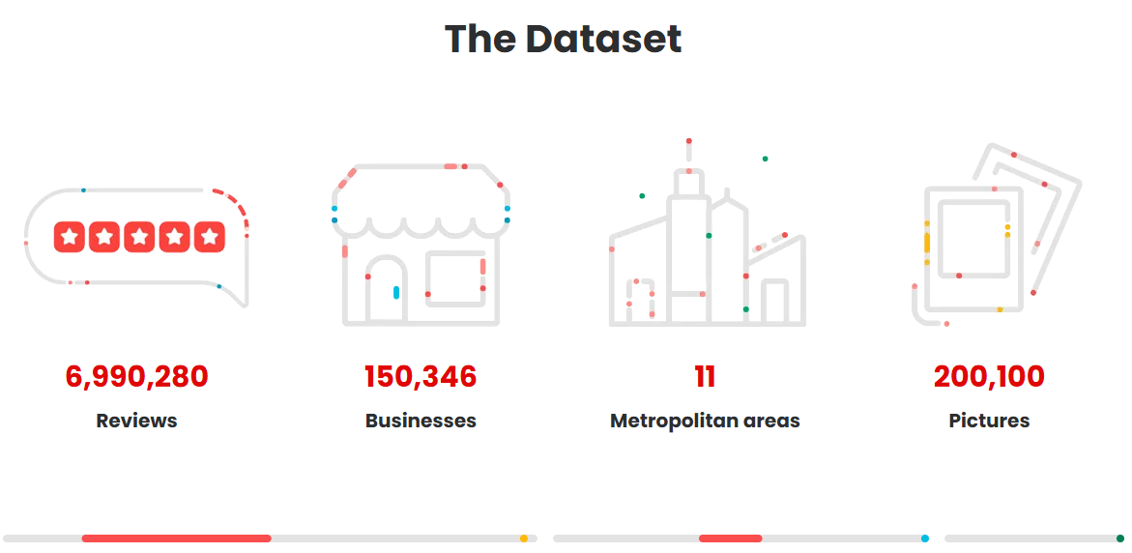

Yelp Restaurant Review Platform
Aamir Mohammed

Slide 2
Project Overview and Objective:
This capstone project will aim to build an end-to-end restaurant review pipeline using the Yelp Open Dataset. It will utilize natural language processing, machine learning, deep learning, and will attempt to use Generative AI capabilities, to analyze customer reviews, predict restaurant ratings and sentiment, and generate summaries of restaurants. The data will be deployed as an interactive Gradio web application for interactivity with users and visualization.
• Build an end-to-end AI pipeline using Yelp restaurant reviews
• Analyze customer sentiment from review text
• Predict restaurant star ratings using machine learning
• Apply deep learning and transformer models for NLP tasks
• Generate AI-powered summaries using LLMs
• Deploy results in an interactive Gradio website
01
04
02
05
03
06

Slide 3
The Yelp Dataset:
• 150,346 total businesses • 6.9M+ total reviews • Filtered to 52,268 restaurants • ~4.7 Million+ restaurant reviews retained
Restaurant Data Columns
• business_id – Unique restaurant identifier • name – Restaurant name • city / state – Location information • stars – Overall restaurant rating • review_count – Total number of reviews • categories – Type of cuisine or restaurant category • is_open – Whether restaurant is currently operating
Review Data Columns
• review_id – Unique review identifier • business_id – Links review to restaurant • user_id – Reviewer identifier • stars – Star rating given in review • text – Full review text (main NLP feature) • date – Review timestamp • useful / funny / cool – User engagement metrics

Slide 4
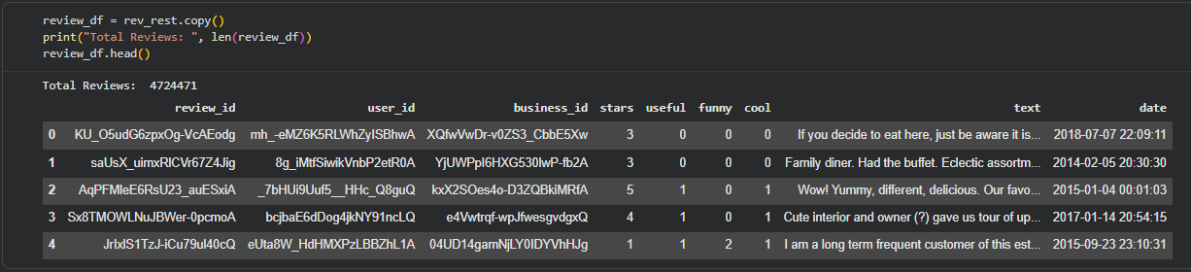
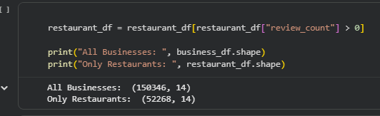
Both Data Files:

Slide 5
Data Filtering and Preprocessing
• Filtered dataset for restaurants only • Processed large Review JSON file in chunks • Handled missing values • Converted dates to datetime format • Cleaned review text (removed URLs, symbols, noise)
• Original review dataset contained millions of entries
• Filtered reviews to include only restaurant-related business IDs
• Saved dataset for only about 750,000 reviews for modeling efficiency and space
• Merged review data with restaurant metadata
• Created final modeling-ready merged dataset with structured + text features

Slide 6
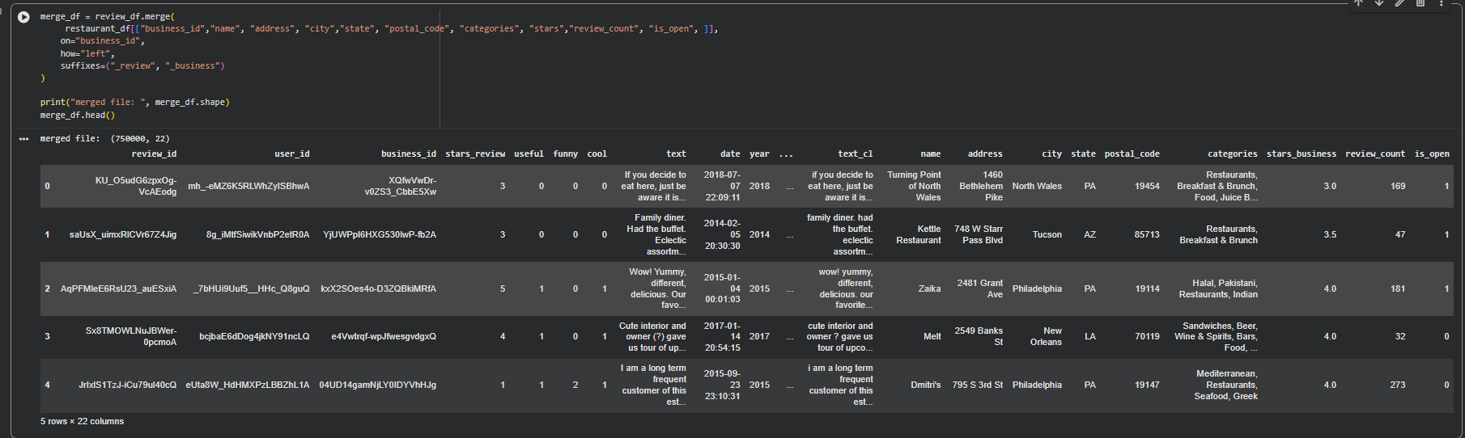
Merged File

Slide 7
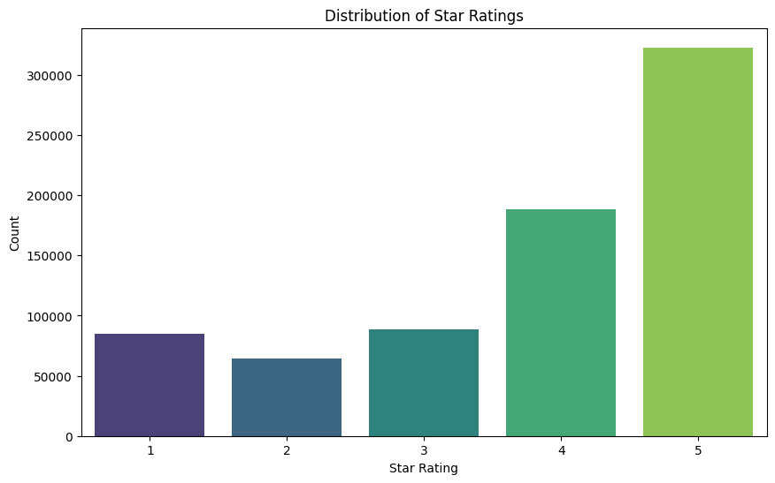
Exploratory Data Analysis
• Final dataset contained 750,000 reviews across 10,042 restaurants
• Rating distribution is positively skewed (majority 4–5 star reviews)
• Average review rating ≈ 3.8 stars, indicating generally positive sentiment
 | stars_review | stars_business | review_count
count | 750000. | 750000. | 750000.
mean | 3.800560 | 3.782142 | 444.46093
std | 1.368162 | 0.612794 | 613.34869
min | 1.000000 | 1.000000 | 5.000000
25% | 3.000000 | 3.500000 | 94.000000
50% | 4.000000 | 4.000000 | 227.00000
75% | 5.000000 | 4.000000 | 528.00000
max | 5.000000 | 5.000000 | 4554.0000

Slide 8
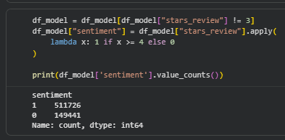
Feature Engineering
Converted star ratings into binary sentiment labels
– ≥ 4 stars → Positive
– ≤ 2 stars → Negative
– Removed neutral (3-star) reviews
Converted Review text into numerical features using TF-IDF
– 10,000 feature limit
Combined text features with structured restaurant metadata
– Business rating
– Review count
– User engagement metrics

Slide 9
Machine Learning: Regression Models
Rating Prediction
• Predicted numerical star ratings (1–5 scale) • Used TF-IDF text features • Evaluated using MSE, RMSE, and R²
applied regression models to predict numerical star ratings from review text.
 | Model | MSE | RMSE | R2
0 | Linear Regression | 0.559776 | 0.74818 | 0.70139
1 | Ridge | 0.558980 | 0.74765 | 0.70182
2 | Lasso | 0.933676 | 0.96626 | 0.50194

Slide 10
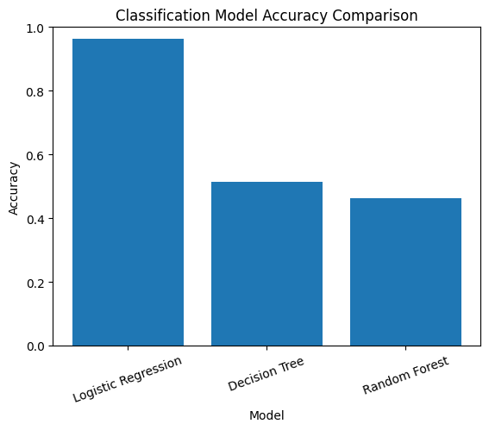
Machine Learning: Classification Models
Logistic Regression
• Predicted positive vs negative sentiment • Accuracy: 96.2% • Strong precision & recall for both classes • Demonstrates text strongly captures sentiment
Predicting 1–5 Star Ratings (Classification)
• Decision Tree Accuracy: ~51% • Random Forest Accuracy: ~46% • Multi-class prediction is more complex
Binary sentiment prediction is substantially easier than exact star rating prediction.

Slide 11
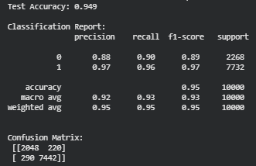
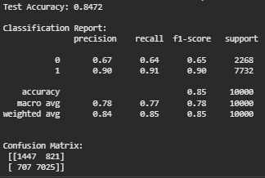
Deep Learning Models:
Dense Neural Network (TF-IDF)
• Input: 5,000 TF-IDF features • 2 Dense layers + Dropout • Binary sentiment classification
Test Accuracy: ~95%
LSTM (Sequence Model)
• Tokenization + Padding (max length = 200) • Embedding layer + LSTM • Captures word order & context
Test Accuracy: ~85%
Binary sentiment prediction is substantially easier than exact star rating prediction.

Slide 12
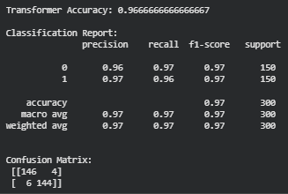
Pre-Trained Transformer Model
Model Used
• Pre-trained DistilBERT • Fine-tuned on SST-2 sentiment dataset • Hugging Face pipeline implementation
Performance
• Accuracy ≈ 96.7% • Precision & Recall ≈ 0.97 • Very strong class balance

Slide 13
Comparison Of Models:
Model | Accuracy
Logistic Regression | 96%
DNN (TF-IDF) | 95%
LSTM | 85%
Transformer (DistilBERT) | 97%

Slide 14
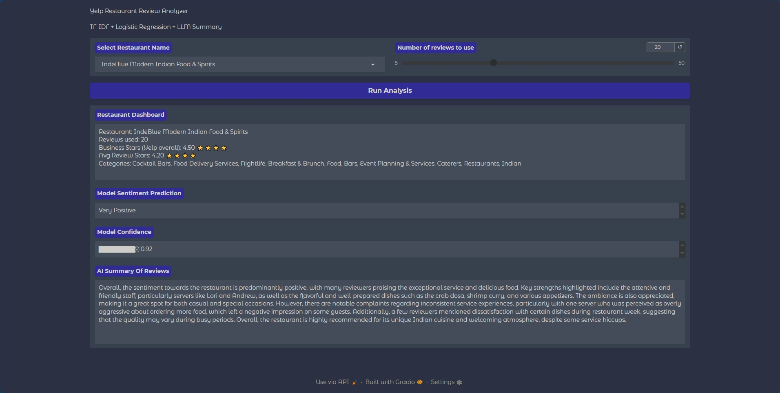
Gradio App Overview:
Interactive web UI to explore restaurants + reviews
Pulls real reviews from the merged Yelp dataset (750K)
Runs sentiment + summary on selected restaurant/reviews
Shows key metrics (avg rating, review count)

